Slide 1
LECTURE ON
Unsigned and Signed Binary Numbers

Slide 2
BINARY SUBTRACTION using 1's Complement
Step 1 : Convert number to be subtracted to its 1’s complement form
Step 2: Perform the addition .
Step 3:(i)If the final carry is 1.then add it to the result obtained in step 2.This is called End around carry.
(ii) If final carry is 0.result obtained in step 2 is negative and in the 1’s complement form.
(I) A - B = A + ( - B ) Here (–B) is a 1’s complement of B.
(II) B - A = B + ( - A ) Here (-A) is a 1’s complement of A.

Slide 3
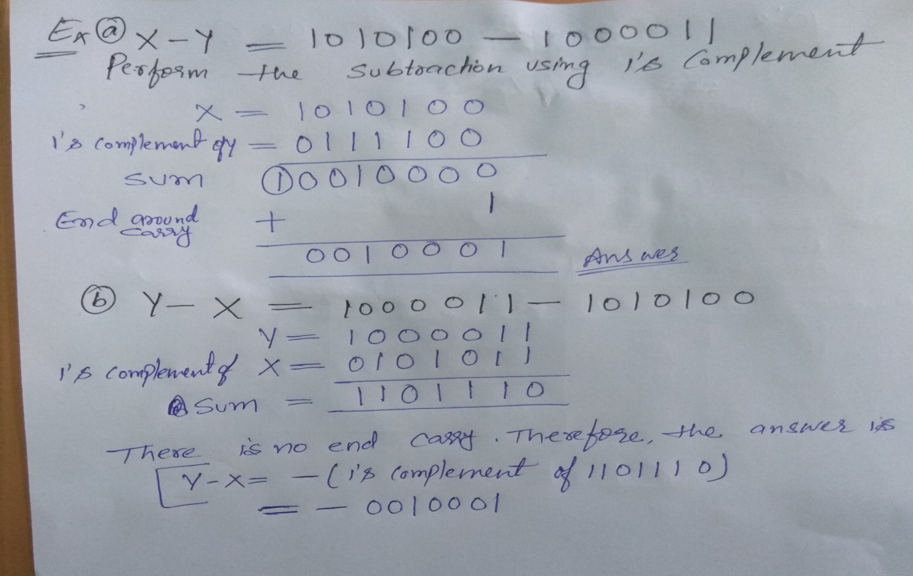
Example:

Slide 4
BINARY SUBTRACTION using 2's Complement
Step 1 : Convert number to be subtracted to its 2’s complement form
Step 2: Perform the addition .
Step 3: (i)If the final carry is generated (final carry is 1)then the result is in its true form. Discard end carry.
(ii)If final carry is not generated(final carry is 0).result obtained in step 2 is negative and in the 2’s complement form.
(I) A - B = A + ( - B ) Here (–B) is a 2’s complement of B.
(II) B - A = B + ( - A ) Here (-A) is a 2’s complement of A.

Slide 5
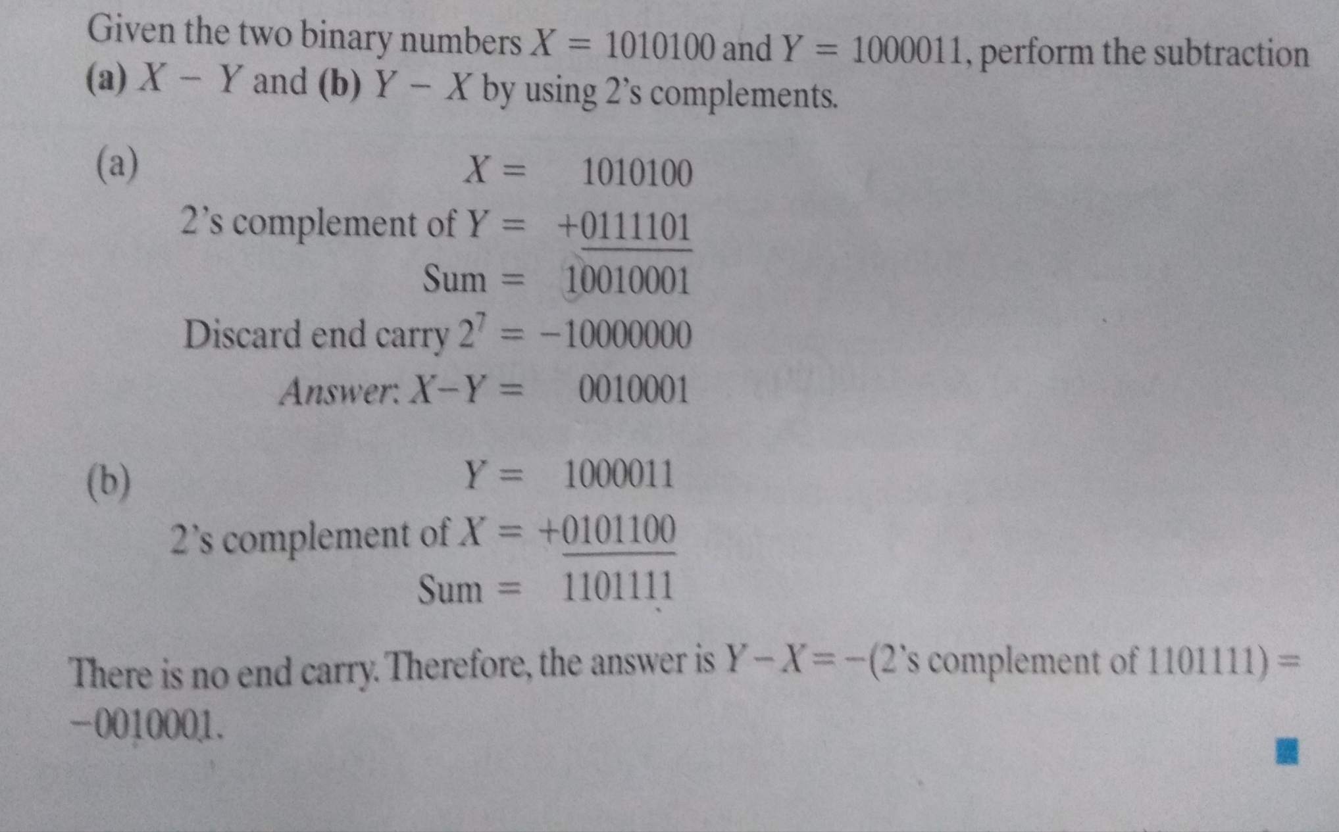
Example:

Slide 6
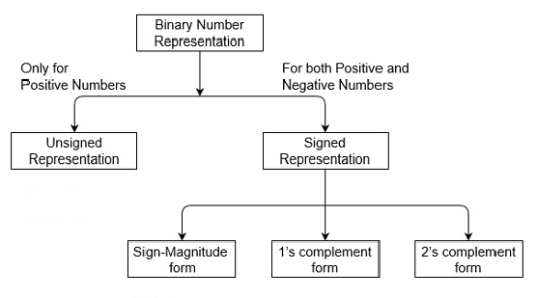
Unsigned and Signed Binary Numbers

Slide 7
Unsigned Binary Numbers
Unsigned numbers don’t have any sign, these can contain only magnitude of the number. So, representation of unsigned binary numbers are all positive numbers only. For example, representation of positive decimal numbers are positive by default. We always assume that there is a positive sign symbol in front of every number.
Representation of Unsigned Binary Numbers:
Since there is no sign bit in this unsigned binary number, so N bit binary number represent its magnitude only.
The range of unsigned binary number is from 0 to (2^{n}-1).
n= number of bits

Slide 8
Unsigned Binary Numbers Examples
Example 1 : Represent decimal number 92 in unsigned binary number.
Simply convert it into Binary number, it contains only magnitude of the given number. = (92)₁₀
= (1011100)₂
It’s 7 bit binary magnitude of the decimal number 92

Slide 9
Unsigned Binary Numbers
Example 2: Represent decimal number 47 in unsigned binary number.
Simply convert it into Binary number, it contains only magnitude of the given number. = (47)₁₀
= (101111)₂
It’s 6 bit binary magnitude of the decimal number 92

Slide 10
Signed Binary Numbers
In real life we have to represent signed numbers (like:-12, -45, -32, +11, 12).
Three different systems have been used
Signed magnitude Representation
One’s complement Representation
Two’s complement Representation
NOTE: For negative numbers the sign bit is always 1, and for positive numbers it is 0 in these three systems

Slide 11
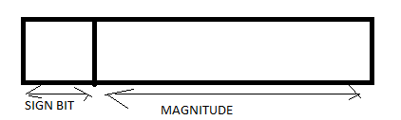
1.Signed Magnitude Representation
The leftmost bit is the sign bit (0 is + and 1 is - ) and the remaining bits hold the absolute magnitude of the number
Examples
-47 = 1 0 1 0 1 1 1 1
47 = 0 0 1 0 1 1 1 1

Slide 12
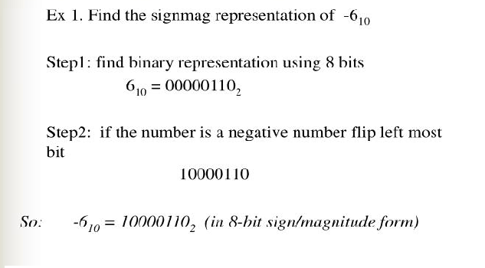
Example:

Slide 13
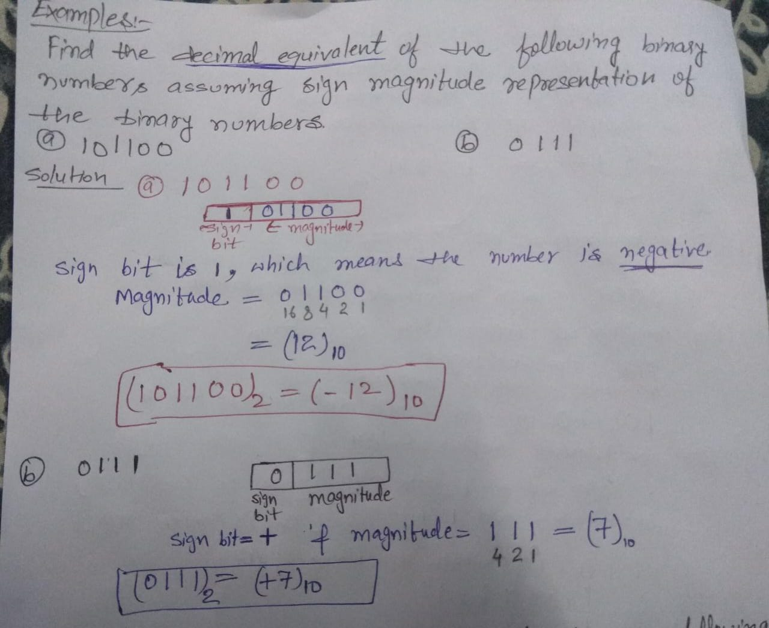
Example:

Slide 14
2. 1’S COMPLEMENT REPRESENTATION
In a binary number, if each 1 is replaced by 0 and each 0 by 1, the resulting number is known as the one’s complement of first number.
1’s complement of 101 is 010
1’s complement of 1011 is 0100
In fact both the numbers are complementing each other. If one of these number is positive, then the other number will be negative with same magnitude and vice versa.
Ex. (0101) represent (+5) whereas
(1010) represent (-5) in 1’s complement representation.

Slide 15
3. 2’S COMPLEMENT REPRESENTATION
If 1 added to 1’s complement of a binary number ,the resulting number is known as the 2’s complement of the binary number.
2’s complement of 101 is 010+1=011
2’s complement of 1011 is 0100+1=0101
. (0101) represent (+5) whereas
(1011) represent (-5) in 2’s complement representation.
In this representation also (same as 1‘s complement ) if the MSB is 0 the number is positive, whereas if the MSB is 1 the number is negative.

Slide 16
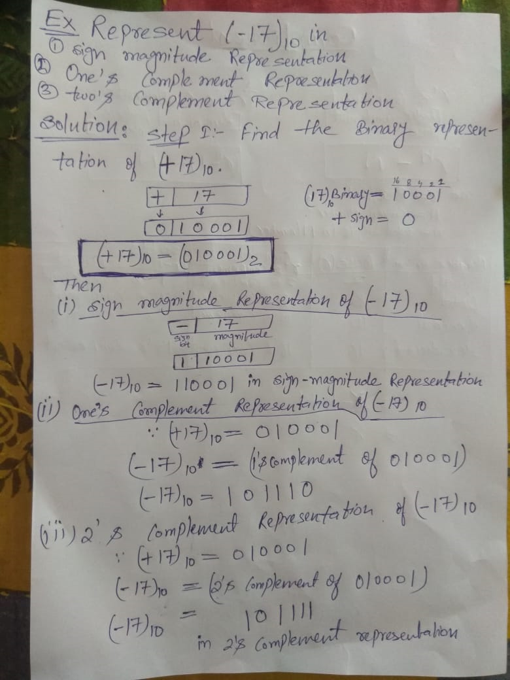
Example:

Slide 17
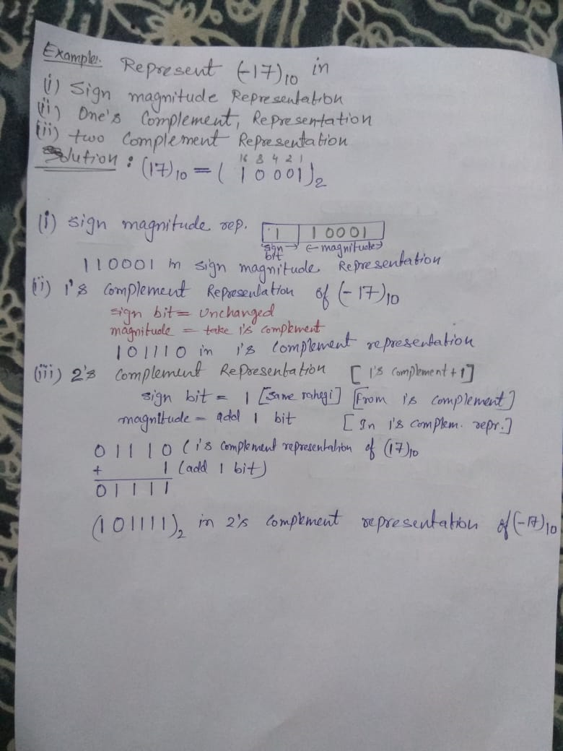
Example: same example

Slide 18
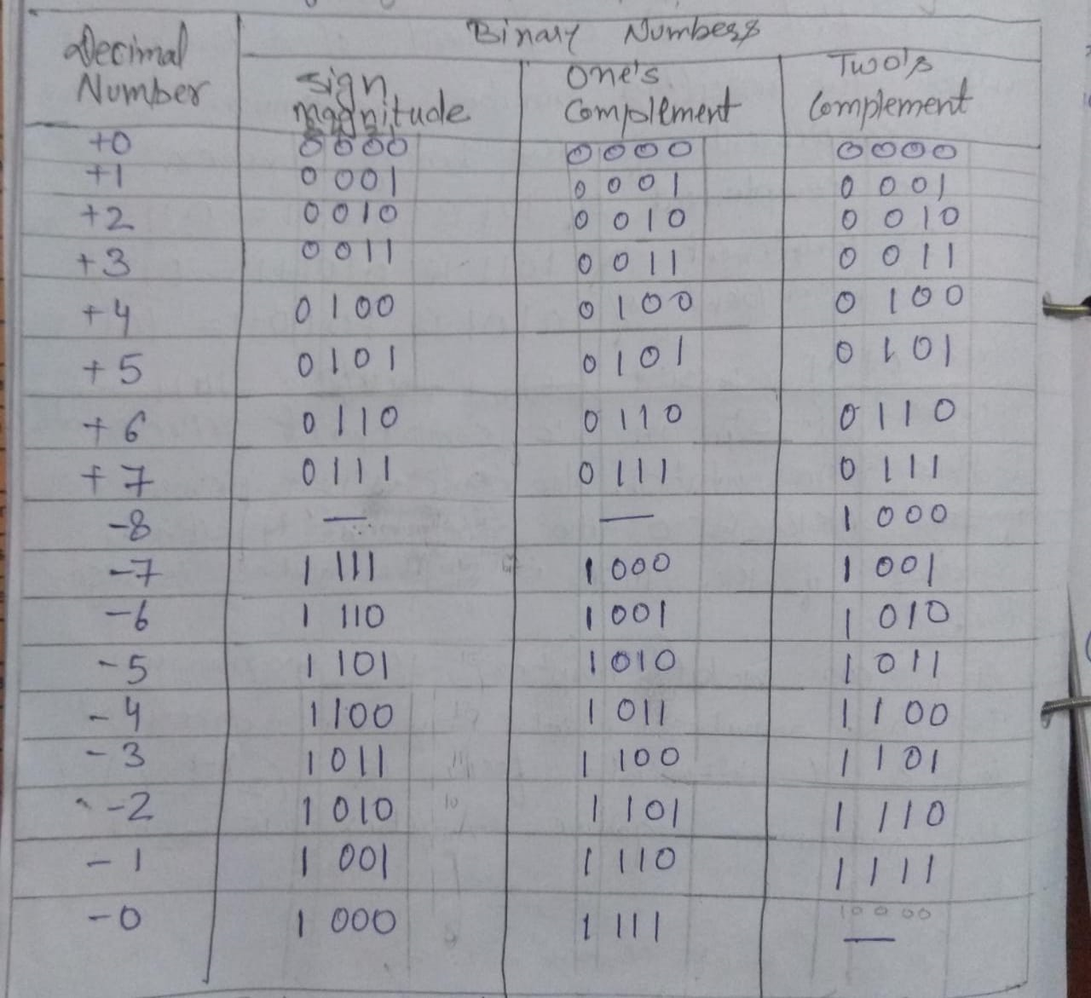
Sign magnitude,1’s complement & 2’s complement Representation using four bit

